Slide 1


F5 LTM Learning with
Alexander S
    Bonus Chapter 01 – Install IIS on windows Server

Slide 2

    Bonus Chapter 01 – Install IIS on windows
    What is IIS?
    Before we begin the installation, let us first understand what IIS is.
    IIS stands for Internet Information Services.
    It is Microsoft’s web server software that comes built into the Windows operating system.
    It allows us to host and publish websites, web applications, and web services.

Slide 3
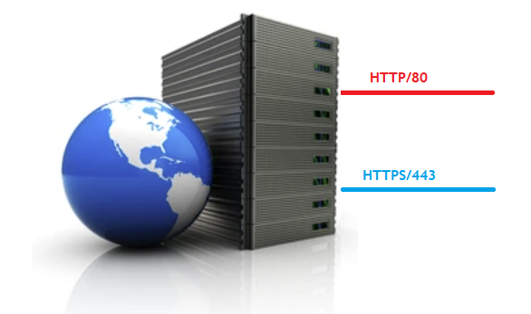
    Bonus Chapter 01 – Install IIS on windows
    What is Web Server?
    A web server is software that listens for HTTP/HTTPS web requests on specific TCP ports.
      The default port for HTTP web request is tcp/80.
      The default port for HTTPS web request is tcp/443.
Web Request
Web Request

Slide 4
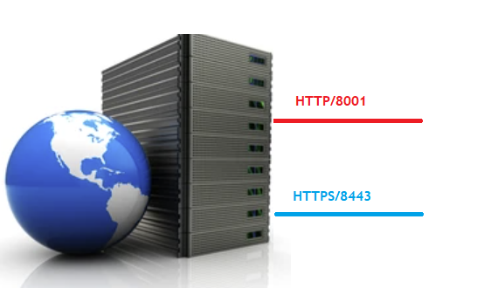
    Bonus Chapter 01 – Install IIS on windows
    Configure using custom port for HTTP & HTTPS
    You can also configure and use custom ports to host HTTP and HTTPS applications.
Web Request
Web Request

Slide 5
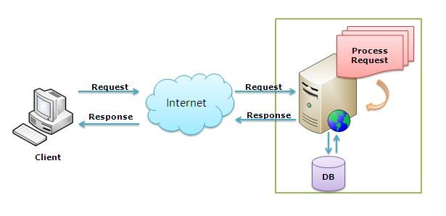
    Bonus Chapter 01 – Install IIS on windows
    What is Web Server?
      tcp/80
    When a client sends a request using web browser, the web server receives the traffic on the configured port and processes it.
    Once processing is complete, the server responds with the appropriate web content - such as HTML pages, images, or application data - which the browser then displays to the user.

Slide 6
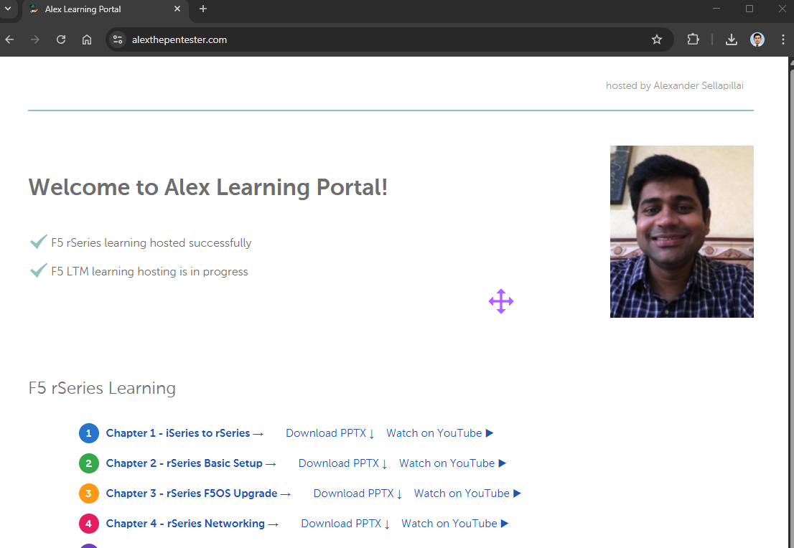
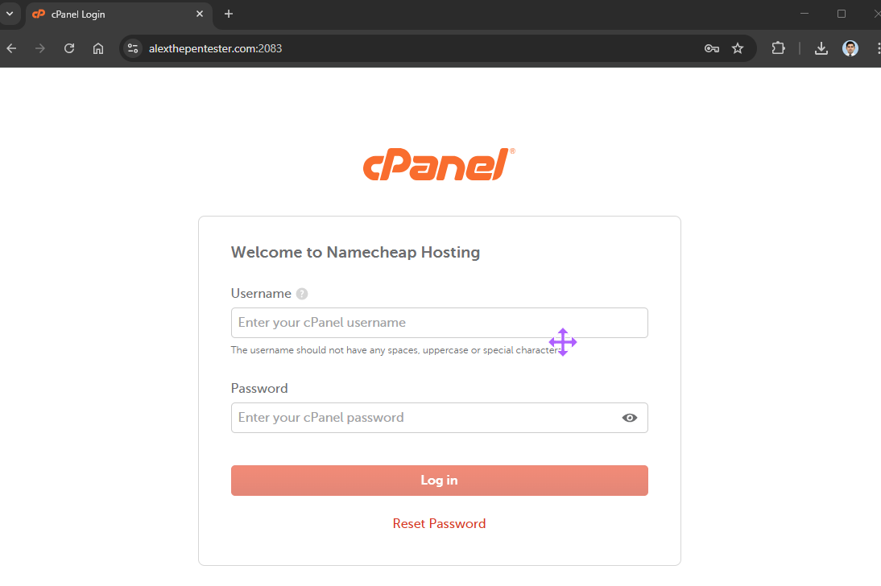
    Bonus Chapter 01 – Install IIS on windows
    Types of websites : Public websites and Private websites
    Public website: can be accessed without authentication
    Example – https://alexthepentester.com
    Private website: access restricted to authenticated users.
    Examples – https://alexthepentester.com:2083

Slide 7
    Bonus Chapter 01 – Install IIS on windows
    IIS supported authentication methods
    Time for question – Does IIS support authentication?
    Yes – IIS supports multiple authentication methods, including
      Anonymous authentication
      Basic Authentications
      Windows authentications

Slide 8
    Bonus Chapter 01 – Install IIS on windows
    Installing IIS software
    Let us install the IIS on the S1_Web-Srv02.Lab.ae

Slide 9
IIS is successfully installed on Windows.
This completes our bonus chapter01 in LTM learning series.
Thank you for watching!

